Slide 1
A Virtual Cluster Manager using a Hierarchical Model for Cloud Infrastructure
Pongsakorn U-chupala
Kasetsart University
Notes:
Thank you, MC. My name is Pongsakorn U-chupala. From Kasetsart University, Thailand. I’d like to talk about our project, A Virtual Cluster Manager using Hierarchical Model for Cloud Infrastructure

Slide 2
Outline
Introduction
Virtualization
Virtual Infrastructure (Cloud Infrastructure)
Virtual Cluster
Problems
Proposal
Virtual Cluster Manager
Evaluation
Case Study
Conclusion
Notes:
This talk is divided into 3 sections
First, the introduction, I’ll explain some basic knowledge and the problem we’re trying to solve.
Second, the Proposal, our proposed solution to the problem
Third, …
Lastly, the Evaluation using Case Study on our proposed solution compare to existing method
*BEWARE OF MY HAND DURING THE PRESENTATION

Slide 3
1. Introduction
Notes:
Let’s start from the introduction

Slide 4

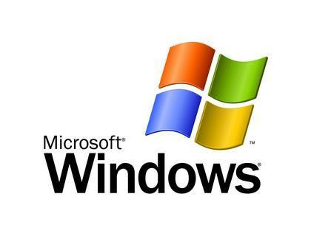
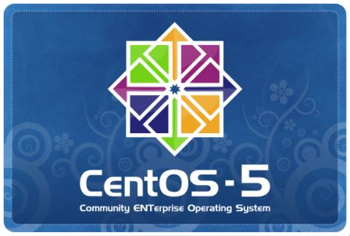
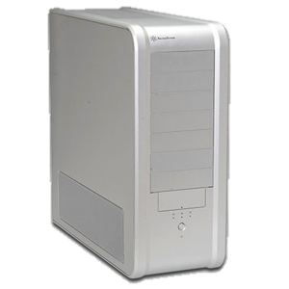



Virtualization
Computer
Notes:
We have a computer here. There’re various demand for computing. Each people need for computing are different.
But we only have limited computational resources.
----- Meeting Notes (1/20/12 16:54) -----
Reduce it here

Slide 5


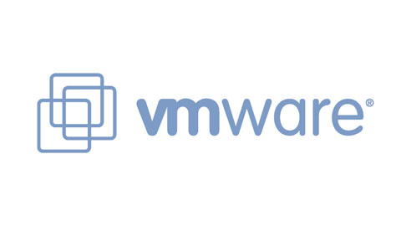
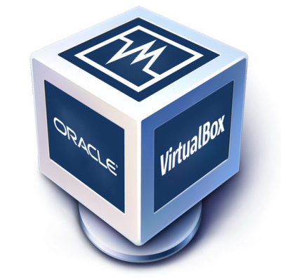
Virtualization
Virtual Machines (VM)
OS
OS
OS
Virtualization Technology
OS
Notes:
So, we have a computer here, it’s run an operation system which can be anything. CentOS in this example.
Thanks to the Virtualization technology, We can install different OS and have different working environment for each user.
*finished fixing this

Slide 6

Virtual Machine (VM)
Computer
Isolated Environment
Notes:
Well, with the technology called “Virtual Machine”
Virtual Machine is a technology to create a virtual computer inside a physical, real computer.
We could also create multiple virtual machine inside single physical machine. Each virtual machine could have separated environment for each user.
Regular user will find no different between real machine and virtual machine.
----- Meeting Notes (1/20/12 16:54) -----
Now VM technology such as … allow ppl to use different os on top of single machine like this
vm tech such as ...
assume we have 1 win, thanks to VM, we can use Linux, Mac on top…
*MODIFY THIS FIGURE

Slide 7







Virtualization Management
Administrator
Manually configure/manage
each physical/virtual machine
for each user
Virtual Infrastructure Toolkit
Virtual Infrastructure (VI)
V
VM
Notes:
Even with Virtualization technology, demands is still increasing. To cope up with these demands, we still need more resources at hand. And who manage these resources and provide services to these users? It’s the Administrator
With VM technology, Let’s say this time, we have a lot of physical machine, each machine also contain a lot of virtual machine. For administrator to manage all of this manually is a very tedious task.
Luckily, we have a technology call Virtual Infrastructure which generalize virtual machine management on a set of physical machine. From administrator perspective, he’ll only need to manage a single large infrastructure instead of separated physical machine.
----- Meeting Notes (1/20/12 16:54) -----
*title background of VI
explain social reason, social background. who is admin?
right now, admin has much diffuculty on management...
add user in the figure
change color and some explanation text

Slide 8
Virtualization Management
Administrator
Virtual Infrastructure
Manually configure/manage
each physical machine
Notes:
With VM technology, Let’s say this time, we have a lot of physical machine, each machine also contain a lot of virtual machine. For administrator to manage all of this manually is a very tedious task.
Luckily, we have a technology call Virtual Infrastructure which generalize virtual machine management on a set of physical machine. From administrator perspective, he’ll only need to manage a single large infrastructure instead of separated physical machine.
----- Meeting Notes (1/20/12 16:54) -----
*title background of VI
explain social reason, social background. who is admin?
right now, admin has much diffuculty on management...
add user in the figure
change color and some explanation text

Slide 9
VI still isn’t the answer
VI Toolkit
Single VM have limited capability, not enough intensive use
Computational power
Storage
One powerful VM isn’t easily scalable in the long run
User could have multiple VM but they need to be configured to work together
Virtual Infrastructure
?
User
Notes:
Having more computers doesn’t make you more productive unless they are properly configured to work together.
----- Meeting Notes (1/20/12 16:54) -----
so far ppl just want to use single machine but right now, according to the computational demand, ppl want to use multiple vm as vc
ppl want to use multiple vm as a single system, VI can't satisfy this reqs
use social background
title: demand for VC

Slide 10



Virtual Cluster (VC)
Virtual Infrastructure
Worker 0
Worker 2
Worker 1
Storage 0
Storage 1
For just 1 user!
Storage Farm
Worker Network
Shared File System
Master
Database
Shared Accounts
Internet
Notes:
With those technologies, It become easy to provide a single virtual machine to user. However, sometime, user need more than 1 VM.
Let’s say we need to provide a number of VM. Each machine have some kind of relationship among one another. We call this set of VM, Virtual Cluster.
It’s not a single VM anymore, It’s a cluster of VM.
----- Meeting Notes (1/20/12 16:54) -----
dificulty setting this up
i.e. shared storage,
slide more than i talk.
such work is require for each user, that why admin work is increasing even with VI
what is admin work?

Slide 11
Problem
VI Toolkit
Virtual Infrastructure allows management of each VM as an individual unit
Deploying a set of VMs and link them together to make a VC need to be done manually
Virtual Infrastructure
Notes:
----- Meeting Notes (1/20/12 16:54) -----
admin has a lot of difficulty in setting VC for *each* user

Slide 12

Problem
Master
Shared Accounts
Shared File System
Worker Network
Database
Worker 1
Administrator
Worker 0
Internet
Storage 0
Storage Farm
Notes:
Managing all of these configuration for each and every user is very tedious task.

Slide 13
Problem
Virtual Infrastructure allows creation/management of each virtual machine as a single unit
Deploying a set of virtual machines and link them together to make a virtual cluster need to be done manually
VM in a VC could span into thousands of machines
Manually maintaining each VM manually is a tedious tasks
Notes:
The problem is…
With VI technology, it’s allow .. as a single, individual unit.

Slide 14
Goal
Make VC management simpler, easier for administrator

Slide 15
2. Proposal
Notes:
Our propose solution to this problem is a Virtual Cluster Manager
----- Meeting Notes (1/20/12 16:54) -----
Top down approach

Slide 16
Proposed Solution
Information needed
to describe VC
Administrator
Virtual Cluster Template Set
Existing VI
management scheme
Provide VC
Management
functionalities
Virtual Infrastructure Toolkit
VI Manager
VC Manager
Notes:
Our proposed solution is to collect all the information needed for a virtual cluster and combine it together to make a VC template set.
To make VI toolkit understand this new format of information, we create a VC manager which is a utility that extended VI manager, the existing VI management method.
This VC manager also provide VC management functionalities to VI
----- Meeting Notes (1/20/12 16:54) -----
extend vm template to vc
explain the effort
use top down approach

Slide 17

VC Template Set
Understandable by VI Manager
Understandable by
VC Manager
VM Characteristic
VM Relationships
VM Template
VM Template
Virtual Cluster Template Set
VM Templates
Documentation
VM Characteristic
Understandable by Human (Administrator)
Notes:
Currently, VC information was split into 2 part. First is VM templates which is an information already used to communicate with VI so it’s already understandable by VI manager. Information on VM Characteristic is contained here.
Second is the documentation created and used by administrator. This information is only understandable by Human. Another part of VM characteristic information and VM relationships information is contained here.

Slide 18
VM Characteristic
Worker
Master
Storage
Database
Storage Farm
Worker Network
Shared File System
Notes:
Characteristic is the information about each VM specifications, configurations as well as shared

Slide 19
VM Relationships
Master
Control
Install
Control
Access data
Worker
Access the Internet
Storage
Access data
Store data
Notes:
Relationships is information on how each VM associate among one another. How they relate to each others. It’s a web of complex relationship

Slide 20
Current Solution
Create/Consult
Documentation
VM Relationships
VM Dependencies
VM Template
VM Template
VM Templates
Virtual Infrastructure
Virtual Infrastructure Manager
Existing VI
management scheme

Slide 21
Proposed Solution
Information needed
to describe VC
Administrator
Virtual Cluster Template Set
Existing VI
management scheme
Provide VC
Management
functionalities
Virtual Infrastructure Toolkit
VI Manager
VC Manager
Notes:
----- Meeting Notes (1/20/12 16:54) -----
extend vm template to vc
explain the effort
use top down approach

Slide 22
Virtual Cluster Manager
A utility for virtual cluster management
Single point of operation for deployment, stop/suspension, deletion and monitoring VC
Work in coordination with existing virtual infrastructure management scheme
Understand complexion of virtual cluster
Characteristic of each VM in a VC
Relationships between each VM in a VC

Slide 23
Virtual Cluster Manager
A utility for virtual cluster management
Single point of operation for deployment, stop/suspension, deletion and monitoring VC
Work in coordination with existing virtual infrastructure management scheme
Understand complexion of virtual cluster
Characteristic of each VM in a VC
Relationships between each VM in a VC

Slide 24
VC Hierarchical Model
A model to represent virtual cluster
Divided into 2 hierarchies
Structural hierarchy ⬅ Characteristic
Group similar VMs together
Dependency Hierarchy ⬅ Relationships
Used to determine order of VM in which operation will be performed to
Notes:
This is the part where I put most of my effort on to but due to time constraint, I couldn’t explain about this in detail.
Group VM with similar characteristic/role together
----- Meeting Notes (1/20/12 16:54) -----
because of time restriction, i'll explain 1 hierarchy
in order to make this point, i spent much effort on this model but because of time restriction is...
dependencies <-> relationship the different is not clear
relationship is too general

Slide 25
1. Structural Hierarchy
Virtual Cluster
VM Type
Virtual Machine
VM Type
Virtual Machine
Virtual Machine
VM Type
Virtual Machine
Virtual Machine
Notes:
Just show and skip
----- Meeting Notes (1/20/12 16:54) -----
show simple slide that reflect relationship and dependencies instead

Slide 26
2. Dependency Hierarchy
VM Type 0
VM Type 2
VM Type 1
VM Type 3
VM Type 4
Notes:
Just show and skip

Slide 27
Example VC
Master 0
Worker 0
Worker 1
Worker 2
Notes:
Just show and skip

Slide 28
Example VC
My Virtual Cluster
VM Type: Master
VM Type: Worker
Master 0
Worker 0
Worker 1
Worker 2

Slide 29
3. Evaluation

Slide 30
Case Study
We have implemented a VC manager with described design using OpenNebula (VI) as a building block
Then did a case study with
OpenNebula-provided utilities (default management scheme)
Our implemented VC manager
Point of interest: Ease of Use

Slide 31
Ease of Use
Assumption: The lesser the size of input there is, the easier it become
Deploy an example virtual cluster
Measure “ease of use” with number of commands and template files, which represent a size of input, used to deploy a virtual cluster
Notes:
The lesser the size of input it is, the easier it become. Of course, result of the input must stay the same.

Slide 32
Example VC
Master 0
Worker 0
Worker 1
Worker 2

Slide 33
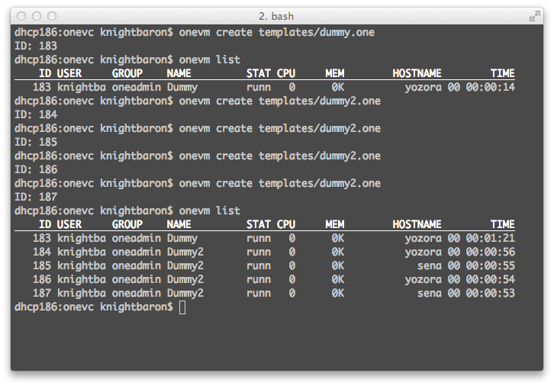
Commands

Slide 34
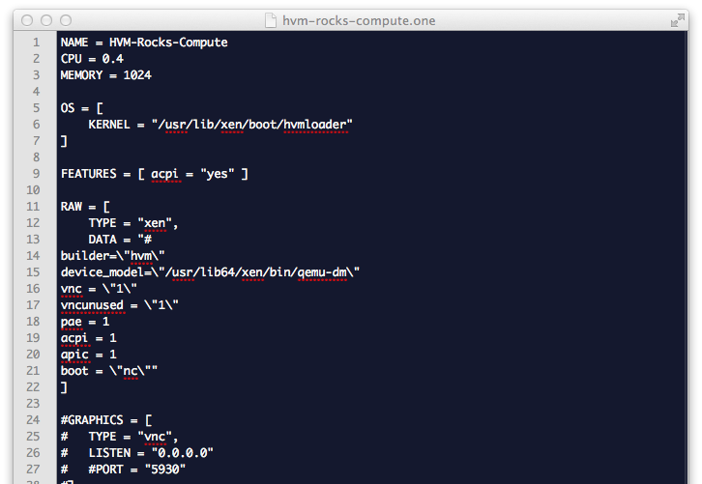
Template Files

Slide 35
Results
Default Scheme
VC Manager
2 template files used
3+n commands used
n is a number of worker
3 templates file used
2 commands used
Notes:
----- Meeting Notes (1/20/12 16:59) -----
draw a graph

Slide 36
# of Template Files Used

Slide 37
Results
Although VC manager requires 1 more template, a number of commands used is a lot less than using default management scheme especially at higher number of worker

Slide 38
4. Conclusion

Slide 39
Conclusion
“VC manager” is our approach to simplify virtual cluster management for administrator
VC Hierarchical model is developed to describe VC and its complexion to the manager
Case study we did show that our approach is better the current management scheme
Notes:
*SKIPPABLE
Add that I did implemented the manager
- This research, I,

Slide 40
Publication
The paper on this work was published in the proceeding of the 6th International Conference on Ubiquitous Information Technologies & Applications at Seoul, Korea on December 15-17, 2011

Slide 41
I’d like to thank
ShimojoLab @ Cybermedia Center
Osaka University
Japan Student Services Organization (JASSO)

Slide 42
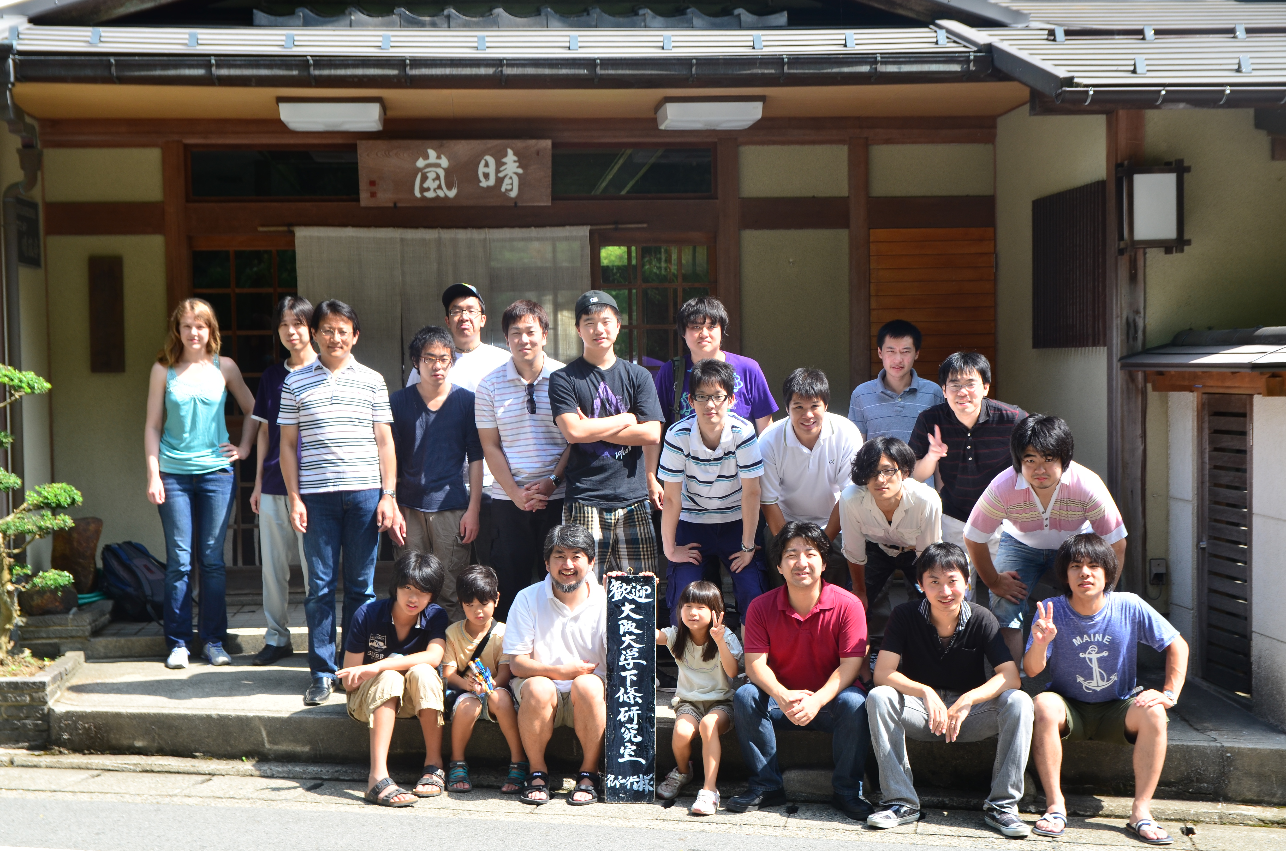
Thank You Very Much!

